Slide 1
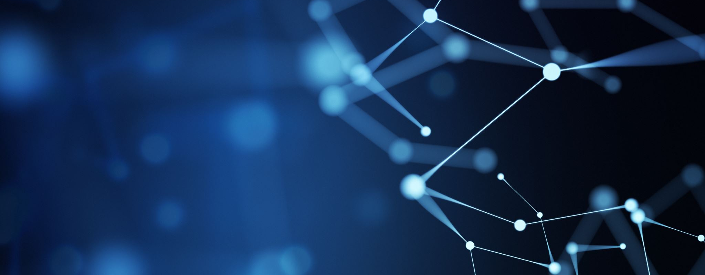
NASA Space Apps: Model Zoo Challenge
TEAM: NASA bois
Team Members: Ronav Roy Chowdhury, Mansoor Lunawadi, Daniel Oliveira, Andrew Chen, Bacem Karran

Slide 2
Challenge & User Experience
The challenge we chose to address was:
What are the effects of space travel on DNA?
Our created model zoo will enable users to get a glimpse into how the ATCG base pairs change across a variety of species in space.

Slide 3
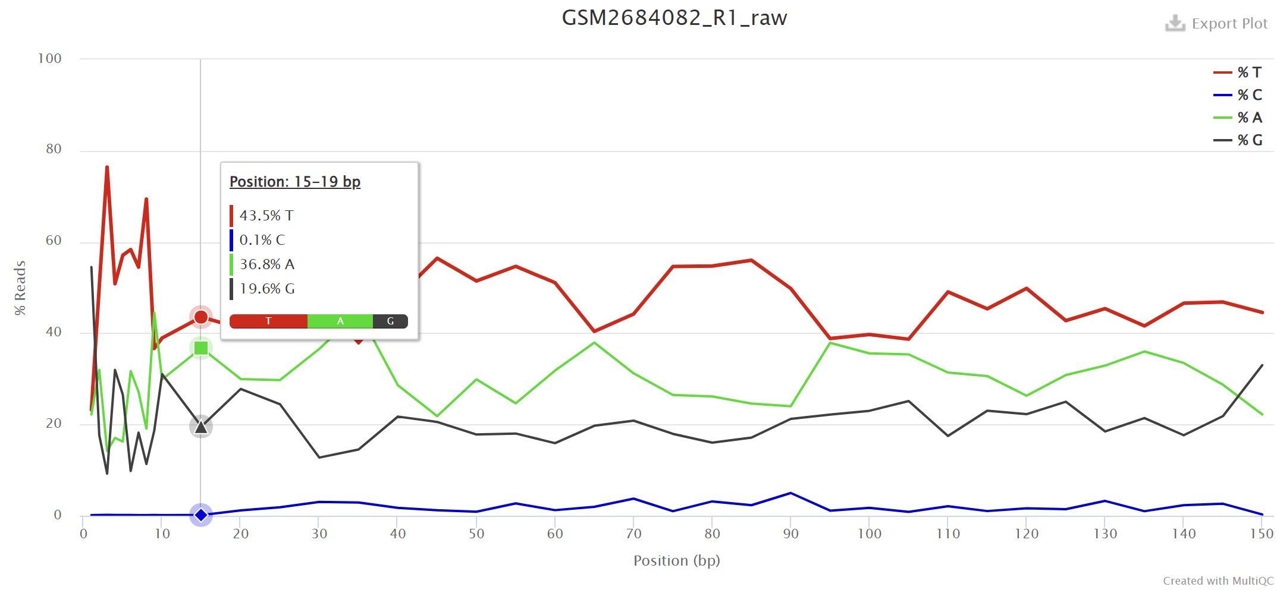
Relevant Datasets
Our model zoo consists of data compiled from 3 main datasets:
Mice
Zebrafish
Arabidopsis thaliana Plants
A sample graph of ATCG levels was examined from all datasets to see if a difference in ATCG levels existed

Slide 4
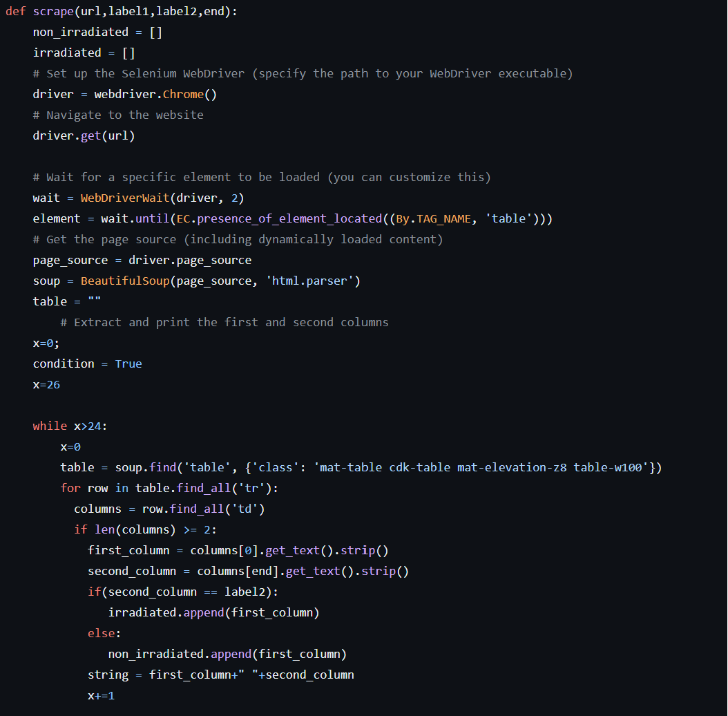
Data Processing
The first step of processing data involved web scraping using the following python libraries:
1. Selenium
- Accessed/opened the website of choice and pass the page source/HTML
- Clicked ‘next’ button when table exceeded 25 rows
2. BeautifulSoup4
- Read and saved all the relevant data from the ‘sample name’ and ‘irradiated/not irradiated’ columns
Snippet of code for web scraping

Slide 5
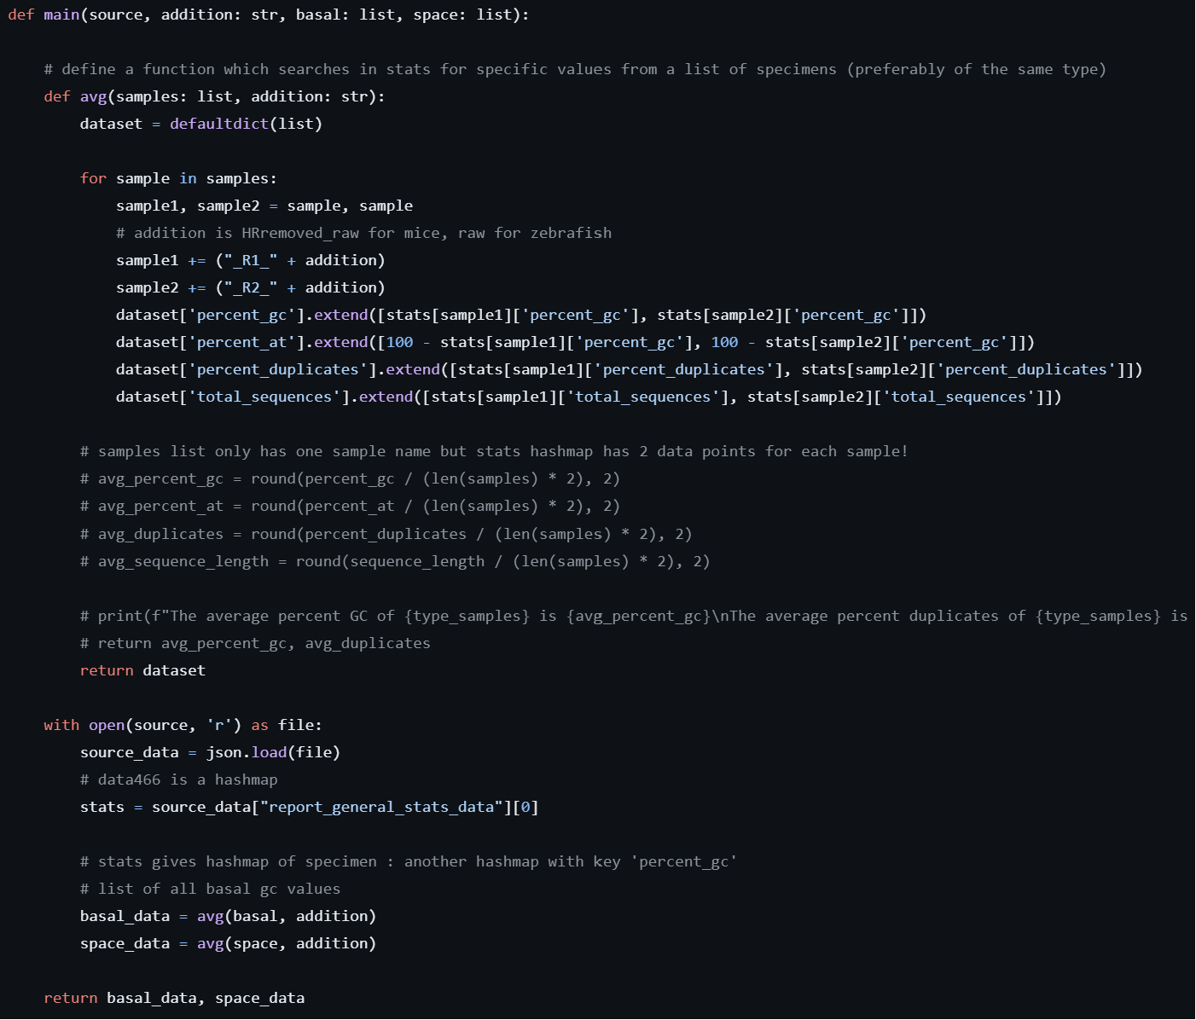
Data Processing (Cont’d)
JSON file was extracted from each dataset and parsed to extract following columns of data:
Percent_GC
Percent_AT
Percent Duplicated (Duplicates of base pairs)
Total Sequences
The fully processed data was in the form of a python dictionary/hashmap with the keys corresponding to the columns above and the values being the list of sample values.
Snippet of Code Used to Parse JSON file

Slide 6
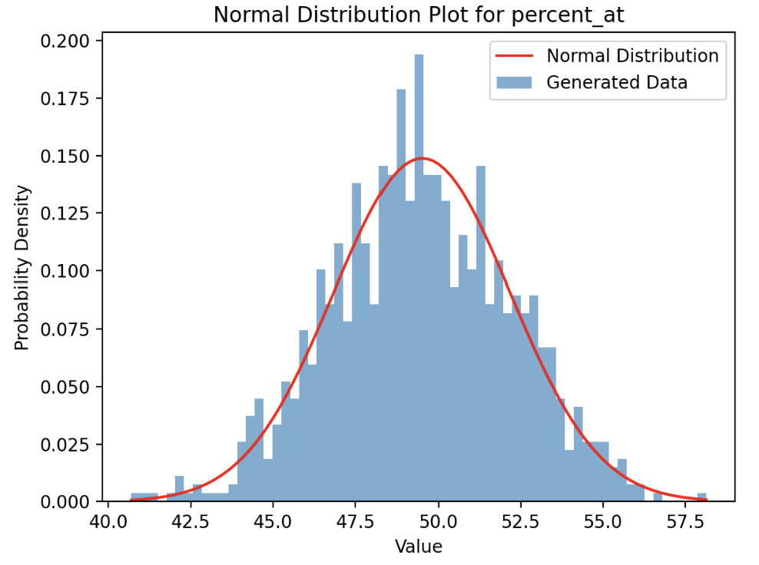
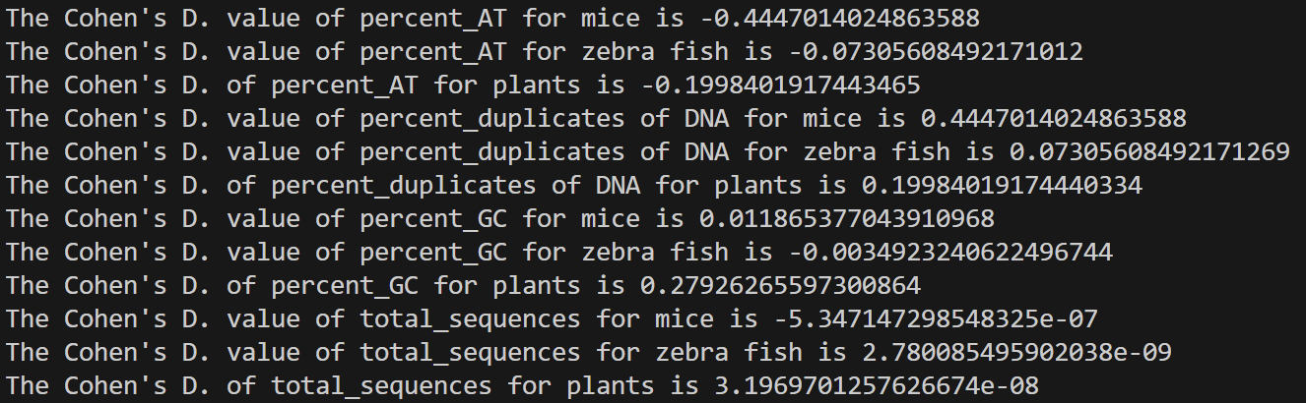
Final Models & Calculations
Normal Distributions
Normal distributions of every key:value pair were created
Cohen’s D Value
Cohen’s D was calculated to determine how far the mean of two relative distributions varied
Cohen’s D value close to 0 indicates very little difference in DNA change before and after space
Positive or negative Cohen’s D value indicates the mean probability value was larger or smaller in space respectively
Sample PDF

Slide 7
What Did We Learn?
OBSTACLES
NEXT STEPS
Datasets did not contain samples that had filled in data for both before space flight and after space flight
Getting specific data from the JSON files
Duplicate samples in JSON file but not on website
We will only use data where samples had both before and after space flight data (not just one of the two)
With this kind of dataset, a neural network could be trained and then fine-tuned (transfer learning) on another smaller dataset

